Slide 1
Portolio allocation focusing on Chinese Companies that trade on U.S. stock exchanges
----ST312 Group project
Group5: Tinsong Li
Yuxuan Chen
Leyao Lin

Slide 2
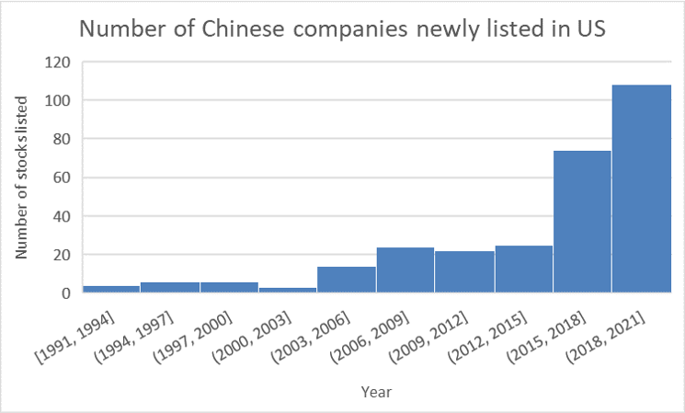
Background
Increasing number of companies listed on US major stock markets
248 companies
market cap. of $2.1 trillion
(USCC, as of May 2021)
Optimistic US investors
Recover from COVID
Alibaba has been among the 5 most owned stocks by hedge funds

Slide 3
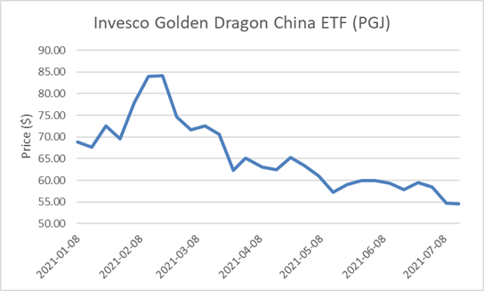

Background
Tenser regulation by Chinese gov.
Tech companies are scrutinized
DiDi, Alibaba, Tencent, etc.

Slide 4
Assets Selection
US-listed Chinese companies
All industry
Have been listed at least 4 years
Ranked by Sharpe ratio

Slide 5
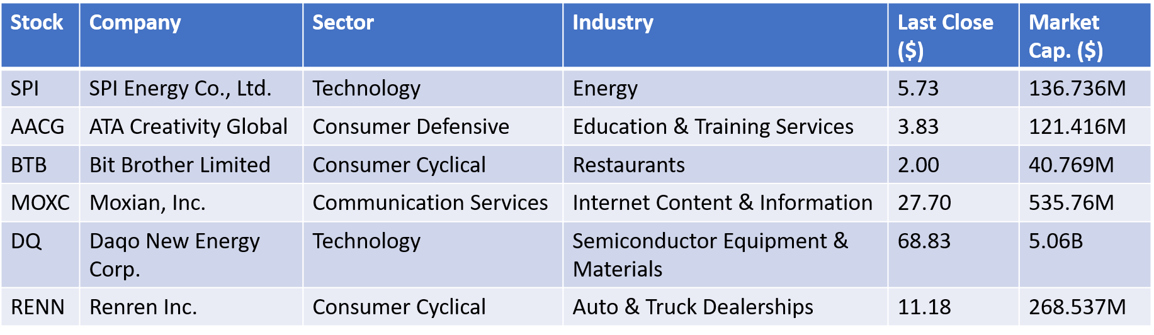
Assets Overview

Slide 6
EFFICENT FRONTIER
&
PORTFOLIO
---- Karl ( Yuxuan Chen)

Slide 7
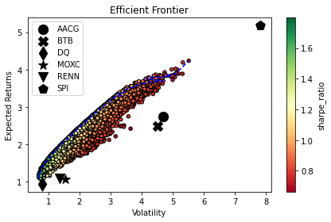
Efficient Frontier
Stocks: SPI, AACG, BTB,
MOXC, DQ, RENN
Method : Monte Carlo simulation

Slide 8
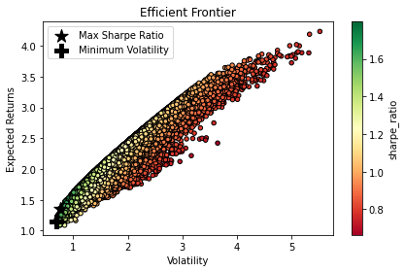
Portfolio on the efficient frontier
quite close !
high volatility
and
high expected returns
 | Returns | Volatility | Sharpe ratio
Maximum Sharpe Ratio portfolio | 135.79% | 75.55% | 179.73%
Minimum Volatility portfolio | 114.99% | 68.80% | 167.15%

Slide 9
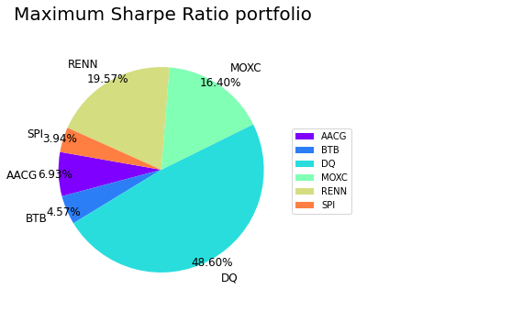
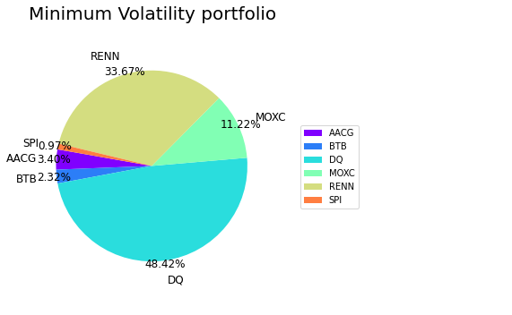
Portfolio
Performance
 | Returns | Volatility | Sharpe ratio
Maximum Sharpe Ratio portfolio (SR) | 135.79% | 75.55% | 179.73%
Minimum Volatility portfolio (MV) | 114.99% | 68.80% | 167.15%

Slide 10
MODEL SELECT
&
Trend forecast
---- May( Leyao Lin )

Slide 11
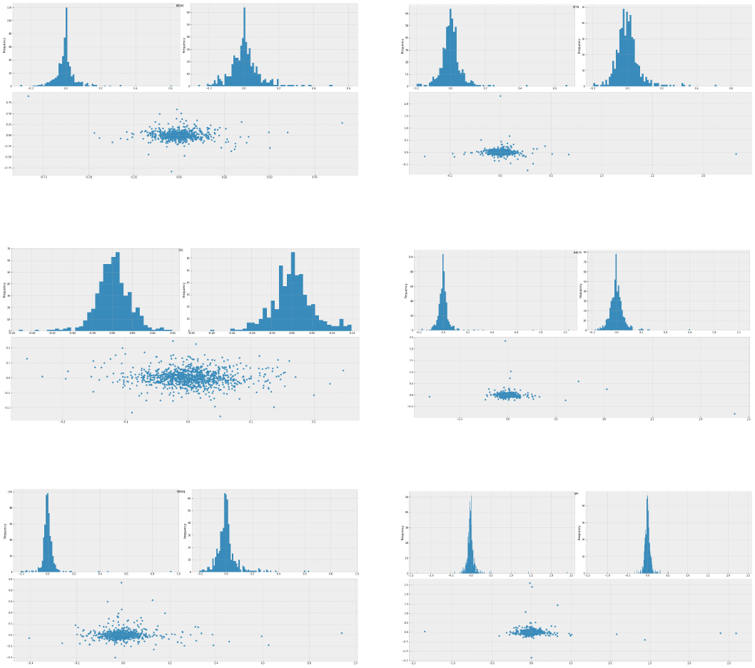
Visualize test of Compound return
MOXC
BTB
DQ
AACG
RENN
SPI

Slide 12
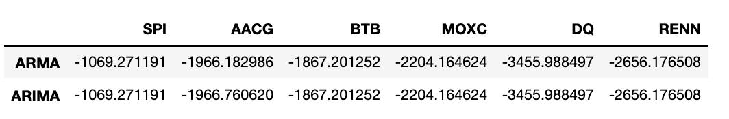
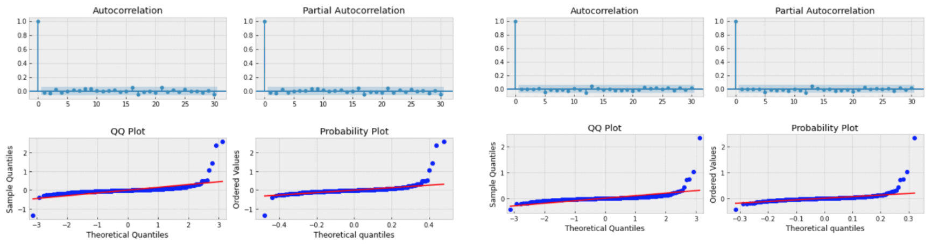
Model selection
ARMA model VS. ARIMA model
Model analysis

Slide 13
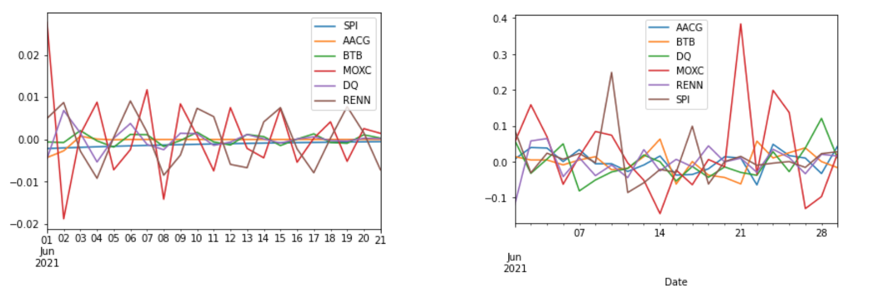
Trend Forecast & Conclusion
Trainning data predict

Slide 14
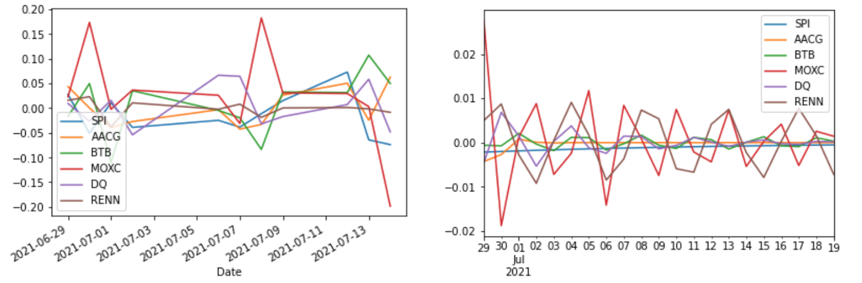
Future trend & Conclusion
Trend Forecast & Conclusion
Future data trend predict

